Slide 1
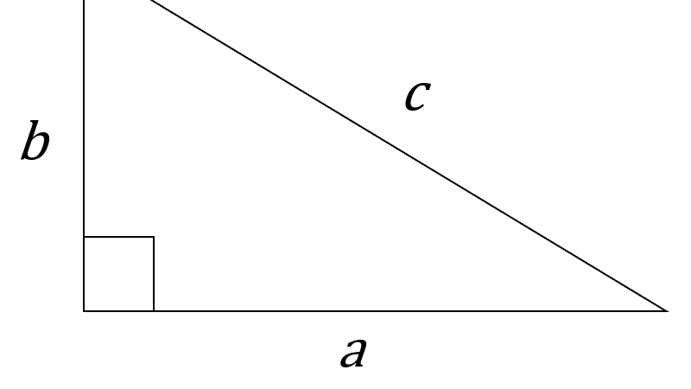
Squaring, Square root, Pythagoras’ theorem and Area
Math 1435 Math Fundamentals
This Photo by Unknown Author is licensed under CC BY-SA-NC

Slide 2
Squaring
To square a number is to multiply it by its self.
7 squared, written 7² is equivalent to 7 x 7 = 49
If your calculator has a x² button, first enter the number you want too square and then press the x² button.
If your calculator does not have a x² button, enter the number you want to square and press the multiplication button (X) then the = button.

Slide 3
Square root
Square root is the opposite of squaring. When you find the square root of a number, you will find a number when multiplied by itself, gives you the original number in the question.
The symbol for square root is √.
Example: The square root of 25 is 5. written as √25 = 5 (5 x 5 = 25)
Most calculators have a √ or √x button. Simply enter the number you want to find the square root and press the √ button.

Slide 4
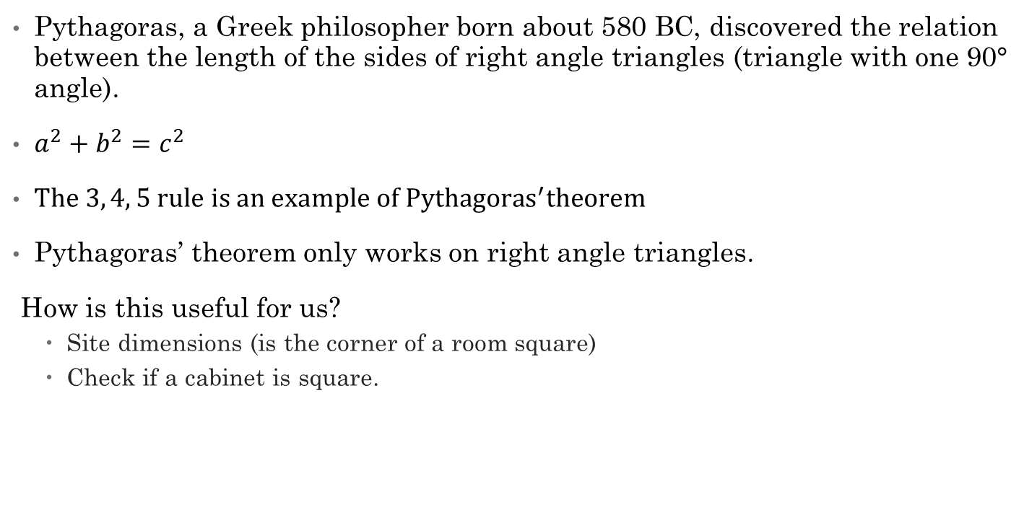
Pythagoras’ Theorem
Pythagoras, a Greek philosopher born about 580 BC, discovered the relation between the length of the sides of right angle triangles (triangle with one 90° angle).
$a^{2}+b^{2}=c^{2}$
$The 3, 4, 5 rule is an example of {Pythagoras}^{′}theorem$
Pythagoras’ theorem only works on right angle triangles.
How is this useful for us?
Site dimensions (is the corner of a room square)
Check if a cabinet is square.

Slide 5
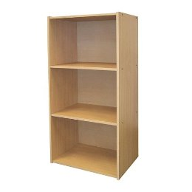
Pythagoras’ Theorem example
Example 1:
You have measured a book shelf, the height measures at 48” and the width measures at 36”, the diagonal measurement is 60”. Is this book shelf square?
C²= A² + B²
C²= (48²)+(36²)
C²= 2304 + 1296
C²= 3600
C = √3600
C = 60

Slide 6
Pythagoras’ theorem example 2
Example 2:
You are on site to take site dimensions for a new job, you need to check to see if the framers made 90° corners but you have forgotten your framing square. You measure 3ft on one wall, 4ft on the other wall. The cross dimension is 4’-10”.
Is the corner square?

Slide 7
Area
Area is the measurement of a surface. Two dimensions are used to calculate area, most commonly length and width.
Consistent units: when calculating area, do not mix units i.e. (m & mm) or (inches & feet).
Area is expressed as units squared. (m², ft², etc.)

Slide 8
Area - Formulas
Area of a rectangle
L x W = area
Area if a square
L² = area
L
W
L

Slide 9
Area – Formulas – rectangle
What if we know the area and one of the dimensions of a rectangle. How do we find the missing dimension?
Area = L x w
875 = L x 25
L = 875
25
L = 35
Length ?
25ft
width
Area =875 ft²

Slide 10
Area – Formulas - square
Can we find the side lengths of a square if all we have is the area?
Area of a square = L²
25= L²
L = √25
L = 5
Area = 25 ft²

Slide 11
Area – Formulas
Area of a triangle
The area of a triangle is equal to ½ that of a rectangle with the same measurements.
Area = base x height
2
height
base

Slide 12
Area – Formulas parallelogram
Area of a parallelogram
Area = base x height
Since the 2 angled ends are opposite of each other, when placed together square the end.
Height
Base

Slide 13
Area – Formulas trapezoid
Trapezoid
To find the area of a trapezoid, calculate the average length of the parallel sides by dividing the total of the parallel sides by 2 then multiplying its answer by the height
Area = Length 1 + Length 2 x height
2

Slide 14
Area – Formulas trapezoid cont.
Trapezoid
Area = Length 1 + Length 2 x height
2
Length 1
Height
Length 2

Slide 15

Area – Formulas definitions
Circle
Diameter (d)- the measurement from one edge of a circle to the other edge, passing through the center.
Radius (r)- the measurement from the center point to the edge.
Pi ($π) 3.1416.$Represents the ratio between the circumference and diameter

Slide 16
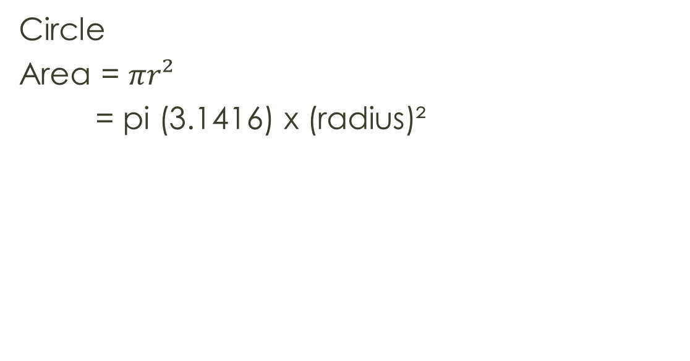
Area – Formulas circle
Circle
Area = $πr²$
= pi (3.1416) x (radius)²
r

Slide 17
Area – Formulas equilateral shapes
Equilateral shapes
For equilateral shapes such as pentagon, hexagon or octagon, divide the shape into equal triangles then calculate the area of one triangle, multiply that answer by the number of triangles in the shape.
Area = base x height x num. triangles
2

Slide 18
Area – Formulas irregular shapes
Irregular shapes
Method 1
Divide the irregular shape into common shapes such as rectangles, squares, circles or triangles then add up the individual areas.
Method 2
Calculate the total area of the irregular shape then subtract the area for the missing sections.

Slide 19
Area – Formulas irregular shapes cont.
Method 1
Method 2

